Slide 1

Rapid Test Data Generation
Using LLM
Komal Chowdhary

Slide 2
What is Test Data?

Slide 3
What is Test Data?
“data which has been specifically identified
for use in tests”

Slide 4

What is Test Data?
Live Data
Test Data

Slide 5
The Test Data Challenge
Growing Complexity
Test data requirements increase with system complexity.
Handling complex data structures becomes a resource-intensive task.
Regular Apps
Smart Apps
Smarter Apps
Very Static, no much changes here
Ex: user enters a number math's is done
Has Data that is not really dynamic
Ex: User account registration
Has Data that constantly changes . Very dynamic
Ex: LinkedIn Homepage

Slide 6




Key Pain Points
Synthetic Data Creation with High Accuracy and Anonymization
Privacy Preservation
Accuracy
Ensure data anonymization to comply with privacy regulations.
Generate synthetic data that closely resembles real-world patterns.
Scalability
Generate large datasets efficiently to meet the demands of the application.

Slide 7

The Opportunity
Generating and Transforming Data with LLMs
LLMs are powerful probabilistic text generators with right prompting
capable of:
Generating diverse test data for various scenarios.
Transforming existing data to fit specific requirements

Slide 8

Prompting Tactics
Tactic 1: Use Delimiters
Define rules for each field explicitly.
Example: % beds | integer | 1 to 6.
Tactic 2 : Ask for Structured Output
Specify the required format (e.g., JSON).
Example: “Return output in valid JSON format.”
Tactic 3 : Check for Assumptions
Instruct the LLM to verify the output meets the requirements before providing results.
Example: “Check that 5 JSON objects have been created before outputting.”
Tactic 4 : Few-Shot Prompting

Slide 9
What is your Data requirements
(Copy it or Fake it)
Data Structure
Data Restrictions
Valid Data
What does JSON look like
Enforcements usually
by backend
Does it make sense
to this Application

Slide 10
Prompting LLMs to generate simple data sets
Example Json Data
{
“firstname”: “Alia",
“Lastname” : “Bhatt",
“email”: “Alia.Bhatt@gmail.com",
“room_name": "Cozy Suite",
"type": "single",
"beds": 1,
"accessible": true,
"image": "https://example.com/room1.jpg",
"description": "Charming room",
"features": ["Wifi", "TV"],
"roomPrice": 150
}

Slide 11
Prompting LLMs to generate simple data sets
Example Json Data
Data Restrictions
firstname string max 15 characters min 3 characters
lastname string max 15 characters min 3 characters
email string format: random@domain.com
room_name string choose one: "Deluxe Room", "Cozy Suite", "Royal Suite", "Family Room"
type string 'single' or 'double'
beds integer constrained by `room_name` rules
accessible boolean
image string domain URL
description string max 20 characters
features array 'Wifi', 'TV', or 'Safe'
roomPrice integer constrained by `room_name` rules
{
“firstname”: “Jack",
“Lastname” : “Jones",
“email”: “Jack.jones@gmail.com",
“room_name": "Cozy Suite",
"type": "single",
"beds": 1,
"accessible": true,
"image": "https://example.com/room1.jpg",
"description": "Charming room",
"features": ["Wifi", "TV"],
"roomPrice": 150
}

Slide 12
Prompt:
You are a JSON data generator. Generate 5 JSON objects with the following format using the Delimiter tactic
and check that 5 JSON objects have been created before outputting the results.
% firstname | string | realistic and meaningful firstname and max 20 and min 3 characters
% lastname | string | realistic and meaningful firstname and max 20 and min 3 characters
% email | string | format: firstname.lastname@gmail.com
% room_name | string | choose one: "Deluxe Room", "Cozy Suite", "Royal Suite", "Family Room"
% type | string | 'single' or 'double'
% beds | integer | constrained by `room_name` rules
% accessible | boolean | true or false
% image | string | random URL
% description | string | realistic and meaningful, max 20 characters
% features | array[string] | 'Wifi', 'TV', or 'Safe'
% roomPrice | integer | constrained by `room_name` rules
Rules
- For `room_name` "Deluxe Room":
- `beds` should be between 1 and 2.
- `roomPrice` should be between 1000 and 2000.
- For `room_name` "Cozy Suite":
- `beds` should be between 2 and 3.
- `roomPrice` should be between 3000 and 5000.
- For `room_name` "Royal Suite":
- `beds` should be between 3 and 4.
- `roomPrice` should be between 10000 and 15000.
- For `room_name` "Family Room":
- `beds` should be between 4 and 6.
- `roomPrice` should be between 8000 and 14000.

Slide 13

Adapting Data Structures with Prompt Reworking :
What If We Need a Different Data Structure?
LLMs offer flexibility to generate test data in multiple formats.
A slight rework of the initial prompt can produce the same data in a different structure, such as XML.

Slide 14
Prompt:
You are a XML data generator. Generate 3 XML entries with the following format using the Delimiter tactic
and check that 3 XML objects have been created before outputting the results.
# rooms
% firstname | string meaningful firstname and max 20 and min 3 characters
% lastname | string | realistic an| realistic and d meaningful firstname and max 20 and min 3 characters
% email | string | format: firstname.lastname@gmail.com
% room_name | string | choose one: "Deluxe Room", "Cozy Suite", "Royal Suite", "Family Room"
% type | string | 'single' or 'double'
% beds | integer | constrained by `room_name` rules
% accessible | boolean | true or false
% image | string | random URL
% description | string | realistic and meaningful, max 20 characters
% features | array[string] | 'Wifi', 'TV', or 'Safe'
% roomPrice | integer | constrained by `room_name` rules
Rules
- For `room_name` "Deluxe Room":
- `beds` should be between 1 and 2.
- `roomPrice` should be between 1000 and 2000.
- For `room_name` "Cozy Suite":
- `beds` should be between 2 and 3.
- `roomPrice` should be between 3000 and 5000.
- For `room_name` "Royal Suite":
- `beds` should be between 3 and 4.
- `roomPrice` should be between 10000 and 15000.
- For `room_name` "Family Room":
- `beds` should be between 4 and 6.
- `roomPrice` should be between 8000 and 14000.

Slide 15

Transforming test data into different formats
The Power of LLMs in Data Transformation
One of the standout features of LLMs:
Ability to translate text (e.g., French ↔ English).
Capability to transform data structures and code.

Slide 16
Transforming test data into different formats
Example : JSON to SQL Transformation
Prompt :
You are a JSON to SQL transformer. Convert the JSON object delimited by triple hashes into a SQL statement .
Check that each SQL statement covers all aspects of the JSON before outputting the results making sure table is there

Slide 17
Prompt:
###
[{
"firstname": "Sally",
"lastname": "Wilson",
"totalprice": 229,
"depositpaid": false,
"bookingdates": {
"checkin": "2017-02-20",
"checkout": "2019-07-05"
},
"additionalneeds": "Breakfast"
},{
"firstname": "Jim",
"lastname": "Jones",
"totalprice": 871,
"depositpaid": false,
"bookingdates": {
"checkin": "2017-08-11",
"checkout": "2021-06-30"
},
"additionalneeds": "Breakfast"
},{
"firstname": "Mary",
"lastname": "Ericsson",
"totalprice": 558,
"depositpaid": true,
"bookingdates": {
"checkin": "2018-07-04",
"checkout": "2022-09-25"
}
}]
###

Slide 18
Rapid Test Data Generation with Reusable Prompts
Quick Prompts for Efficiency
Reusable Prompts:
Replace the data object in the delimited portion of a prompt.
Generate or transform data quickly for various scenarios.
Applications in Testing:
Exploratory Testing: Rapidly create diverse data sets to uncover hidden issues.
Debugging: Generate relevant data on demand to analyze and resolve defects.

Slide 19

Processing complex test data with LLMs
Plain Language Prompts:
Earlier prompts required explicit rule-setting in simple terms.
Relied on us to decode data structures and relationships manually.

Slide 20
Using Format Standards in Prompts
Leveraging Data Specification Formats like OpenAPI v3 and XSD to outline data structures and rules
Why Use Specification Frameworks?
Ready-to-Go Solutions:
Frameworks like OpenAPI and XSD already define data names, types, and relationships.
No need to reinvent the wheel.
Widespread Adoption:
Standardized frameworks are widely used, increasing the likelihood of effective LLM training.
Free Resources:
Specifications are often available within teams during feature or application design.
Intrinsic Testability:
LLMs are likely trained on these common structures, boosting the chances of accurate and valuable output.

Slide 21
JSON with OPENAPI
You are a JSON data generator. Generate a JSON array with 3 randomized JSON objects based on the OpenAPI schema delimited by three hashes.
Confirm that all 3 JSON objects match the OpenAPI schema rules before outputting the results.

Slide 22
JSON with OPENAPI
###
openapi: 3.0.0
components:
schemas:
Room:
title: Room
type: object
properties:
accessible:
type: boolean
description:
type: string
type:
type: string
pattern: Single|Double|Twin|Family|Suite
features:
type: array
items:
type: string
pattern: WiFi|TV|Radio|Refreshments|Safe|
image:
type: string
roomNumber:
type: string
roomPrice:
type: integer
format: int32
minimum: 0
maximum: 999
exclusiveMinimum: true
exclusiveMaximum: false
roomid:
type: integer
format: int32
required:
- accessible
- description
- features
- image
- roomNumber
- roomPrice
###

Slide 23
XML and XSD
You are an XML data generator. Generate 3 randomized XML objects based on the XSD schema delimited by three hashes.
Add all the XML objects to parent element of rooms. Confirm that all 3 XML subobjects match the XSD schema rules before outputting the results.

Slide 24
XML and XSD
###
<?xml version="1.0" encoding="UTF-8"?>
<xs:schema xmlns:xs="http://www.w3.org/2001/XMLSchema">
<xs:element name="room">
<xs:complexType>
<xs:sequence>
<xs:element name="accessible" type="xs:boolean"/>
<xs:element name="description" type="xs:string"/>
<xs:element name="type">
<xs:simpleType>
<xs:restriction base="xs:string">
<xs:enumeration value="Single"/>
<xs:enumeration value="Double"/>
<xs:enumeration value="Twin"/>
<xs:enumeration value="Family"/>
<xs:enumeration value="Suite"/>
</xs:restriction>
</xs:simpleType>
</xs:element>
<xs:element name="features">
<xs:complexType>
<xs:sequence>
<xs:element name="feature"
➥type="FeatureType" minOccurs="0"
maxOccurs="unbounded"/>
</xs:sequence>
</xs:complexType>
</xs:element>
<xs:element name="image" type="xs:string"/>
<xs:element name="roomNumber" type="xs:string"/>
<xs:element name="roomPrice" type="xs:decimal"/>
<xs:element name="roomid" type="xs:integer"/>
</xs:sequence>
</xs:complexType>
</xs:element>
<xs:simpleType name="FeatureType">
<xs:restriction base="xs:string">
<xs:enumeration value="WiFi"/>
<xs:enumeration value="TV"/>
<xs:enumeration value="Radio"/>
<xs:enumeration value="Refreshments"/>
<xs:enumeration value="Safe"/>
<xs:enumeration value="Views"/>
</xs:restriction>
</xs:simpleType>
</xs:schema>
###

Slide 25

SQL exports as prompt guides
The Challenge
Applications often store data across multiple tables in SQL-based databases.
Prompts must generate data distributed across these tables.

Slide 26
Prompt:
You are a SQL generator. Take the sql statement delimited by three hashes and create a SQL statement that generates 5 new records that follow the format of the provided statement.
###
CREATE TABLE rooms (roomid int NOT NULL AUTO_INCREMENT, room_name
➥varchar(255), type varchar(255), beds int, accessible boolean,
➥image varchar(2000), description varchar(2000),
➥features varchar(100) ARRAY, roomPrice int, primary key (roomid));
INSERT INTO rooms (room_name, type, beds, accessible, image,
➥description, features, roomPrice) VALUES ('101', 'single', 1,
➥true, 'https://www.mwtestconsultancy.co.uk/img/testim/room2.jpg',
➥'Aenean porttitor mauris sit amet lacinia molestie. In posuere
➥accumsan aliquet. Maecenas sit amet nisl massa. Interdum et
➥malesuada fames ac ante.', ARRAY['TV', 'WiFi', 'Safe'], 100);
CREATE TABLE bookings (bookingid int NOT NULL AUTO_INCREMENT, roomid
➥int, firstname varchar(255), lastname varchar(255),
➥depositpaid boolean, checkin date, checkout date,
➥primary key (bookingid), FOREIGN KEY (roomid) REFERENCES
➥ROOMS(roomid));
INSERT INTO bookings (roomid, firstname, lastname, depositpaid,
➥checkin, checkout) VALUES (1, 'James', 'Dean', true, '2022-02-01',
➥'2022-02-05');
###

Slide 27
Leveraging LLMs to Generate Test Data for Dynamic Applications Like LinkedIn
Model Realistic User Scenarios
Prompt Example:
"Generate test data for a LinkedIn user profile with the following fields: name, headline, summary, 5 skills and connections (5 with unique names and job titles). Ensure connections are structured as an array of objects.“
2. Simulate Dynamic Activity
Prompt Example:
"Generate 10 sample posts for a LinkedIn user, each with a unique title, description, hashtags, and engagement metrics (likes, comments).“
3. Generate Relationship Data
Prompt Example:
"Create a dataset of 10 LinkedIn users, each with 3-5 connections and mutual endorsements for random skills.“
4. Incorporate Time-Based Variations
Prompt Example:
"Generate 10 user activities over the past week, including posts, likes, and connections, with realistic timestamps."

Slide 28
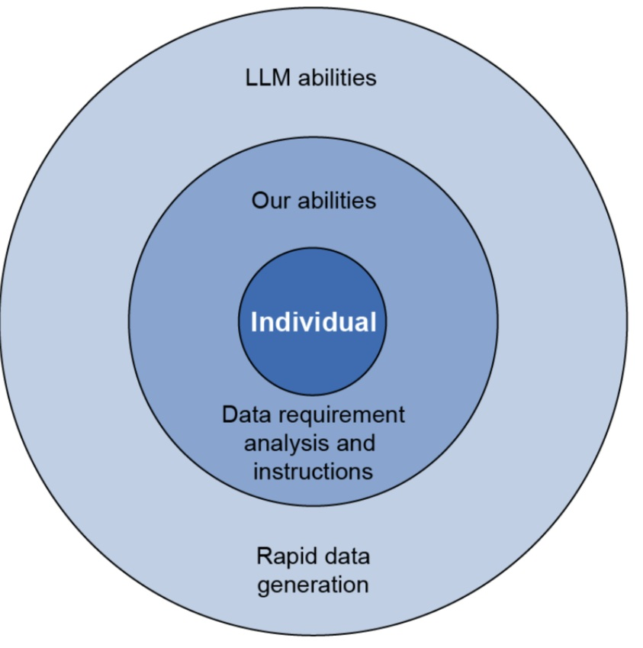
Benefiting from generated test data
Source: Software Testing using Gen AI book by Mark WinterIngham

Slide 29
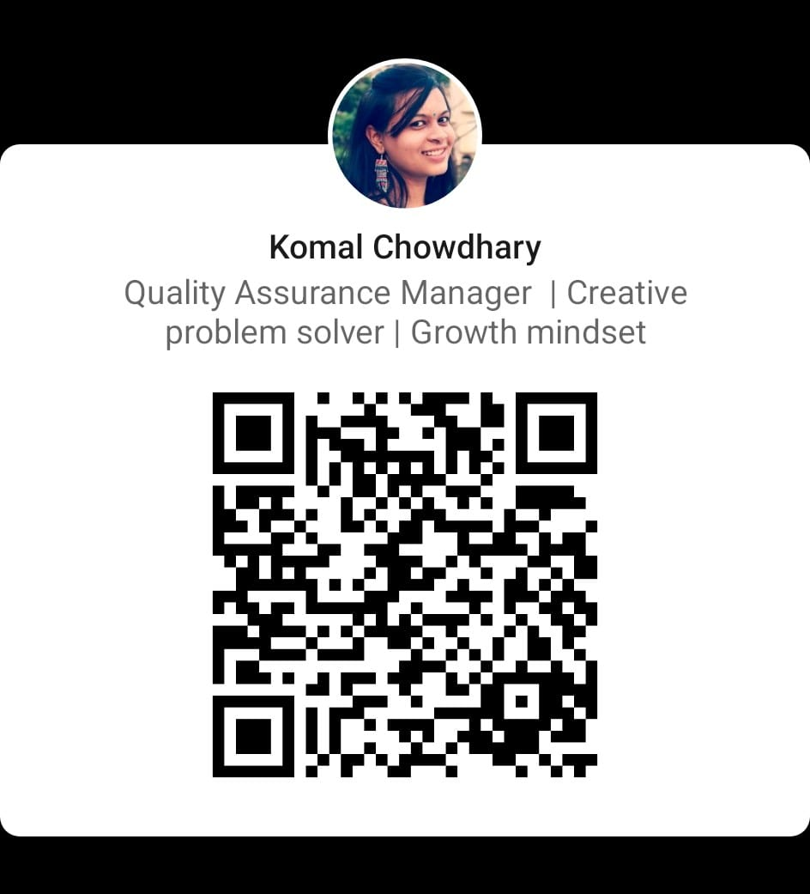
Thank You…

